Slide 1




Astronomy 1010 chapter 17
Clayton State University
Slides for Astronomy textbook from OpenStax
https://openstax.org/books/astronomy/

Slide 2
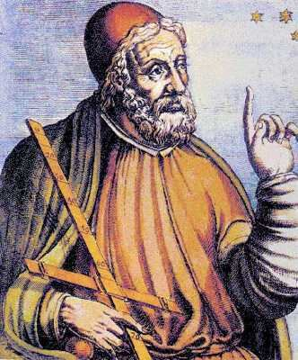
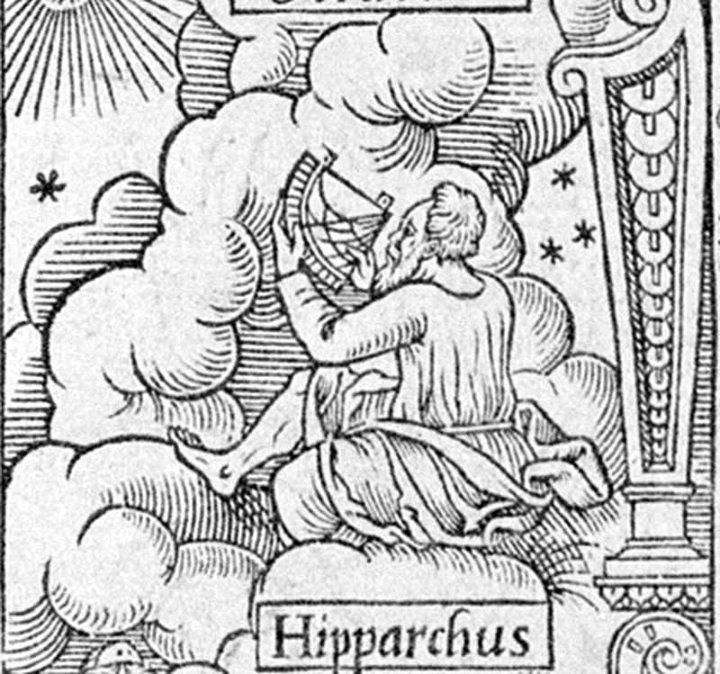
Hipparchus
Perhaps the greatest astronomer of antiquity was Hipparchus, born in Nicaea in what is present-day Turkey. He erected an observatory on the island of Rhodes around 150 BC, when the Roman Republic was expanding its influence throughout the Mediterranean region.
REVISIT
There he measured, as accurately as possible, the positions of objects in the sky, compiling a pioneering star catalog with about 850 entries. He designated celestial coordinates for each star, specifying its position in the sky, just as we specify the position of a point on Earth by giving its latitude and longitude.

Slide 3
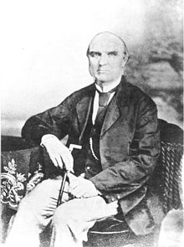
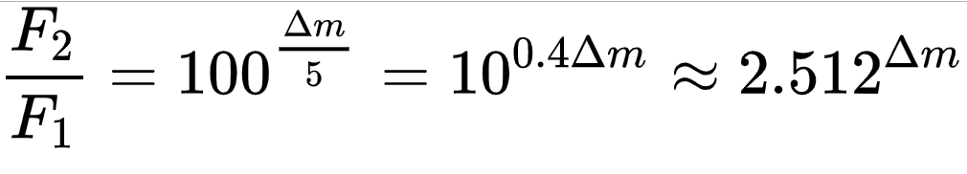
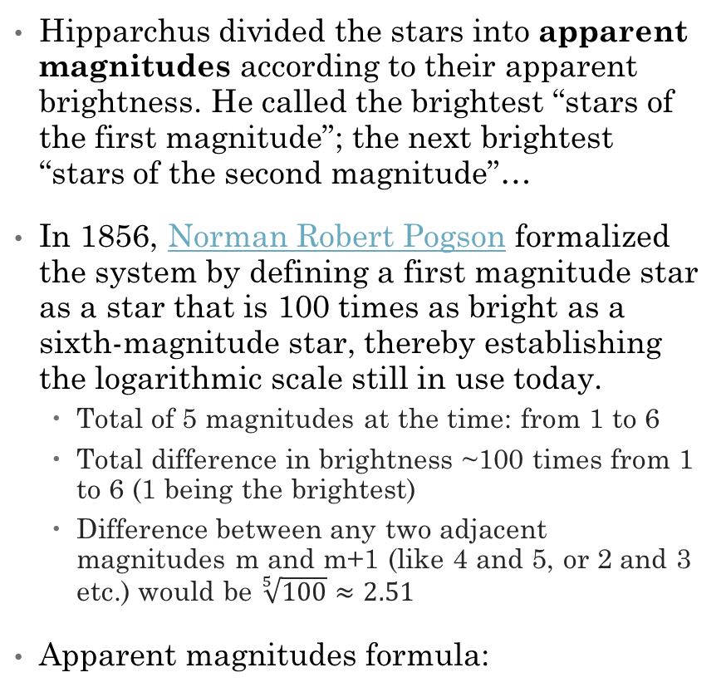
Hipparchus and Magnitudes
Hipparchus divided the stars into apparent magnitudes according to their apparent brightness. He called the brightest “stars of the first magnitude”; the next brightest “stars of the second magnitude”…
In 1856, Norman Robert Pogson formalized the system by defining a first magnitude star as a star that is 100 times as bright as a sixth-magnitude star, thereby establishing the logarithmic scale still in use today.
  Total of 5 magnitudes at the time: from 1 to 6
  Total difference in brightness ~100 times from 1 to 6 (1 being the brightest)
  Difference between any two adjacent magnitudes m and m+1 (like 4 and 5, or 2 and 3 etc.) would be $\sqrt[5]{100}≈2.51$
Apparent magnitudes formula:
REVISIT

Slide 4
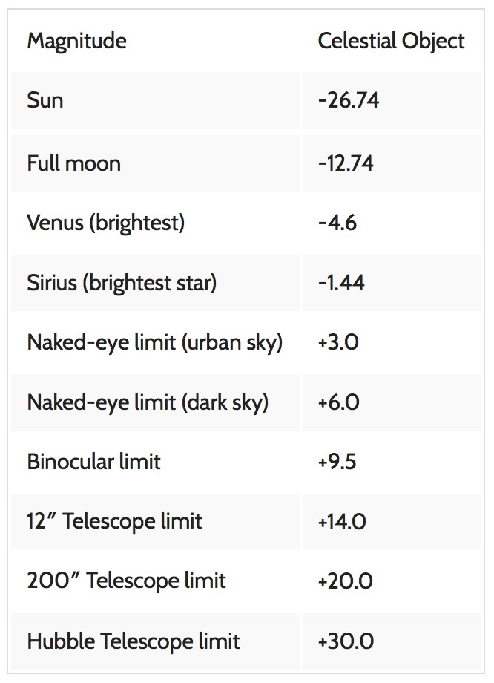
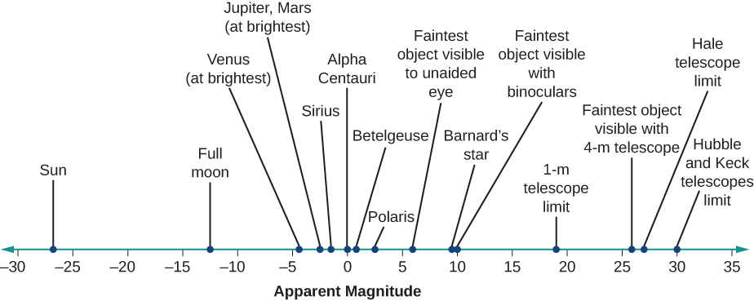
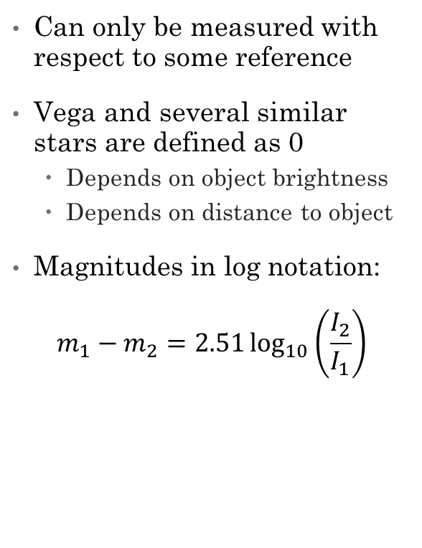
Apparent magnitudes of stars
Can only be measured with respect to some reference
Vega and several similar stars are defined as 0
  Depends on object brightness
  Depends on distance to object
Magnitudes in log notation:
$$m_{1}−m_{2}=2.51\log_{10}\left(\frac{I_{2}}{I_{1}}\right)$$
REVISIT

Slide 5
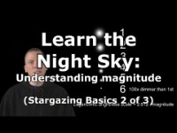
Absolute magnitudes
Apparent magnitudes – how objects appear to be in the sky. But brightness depends on distance – Sun is bright but its very close.
Absolute magnitude – brightness of object as if they are on the same distance from us – 10 parsecs

Slide 6
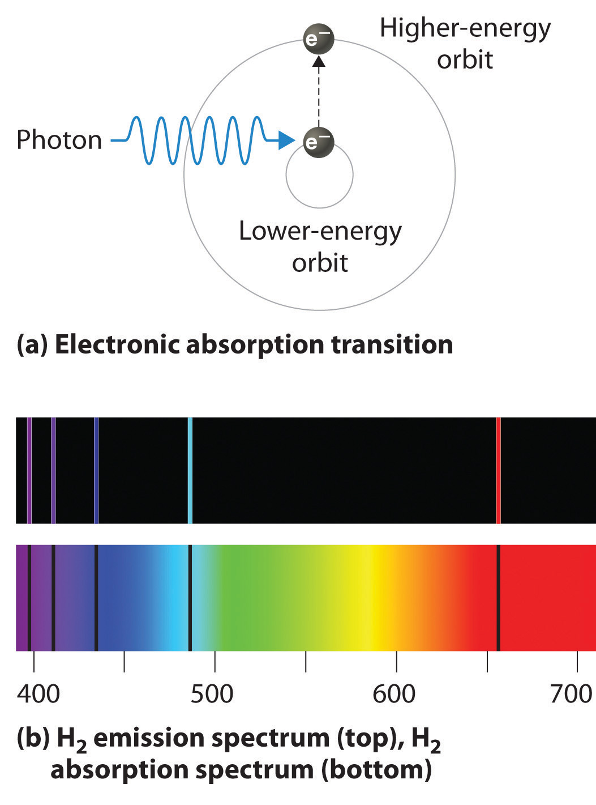
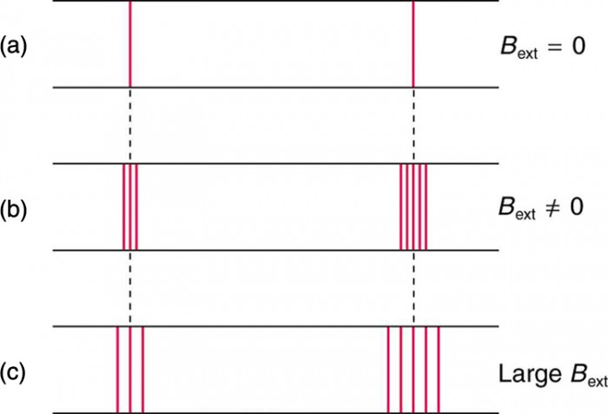
Emission and Absorption spectra
Hot rarified gas will emit district spectral lines
Cold gas will absorb light at the same frequencies
Passport of the element
Width of the lines tells how fast object is rotating and radius
If lines are shifted, we know if object moves away or towards us.
If line is split, if there is magnetic field
See textbook
See textbook

Slide 7
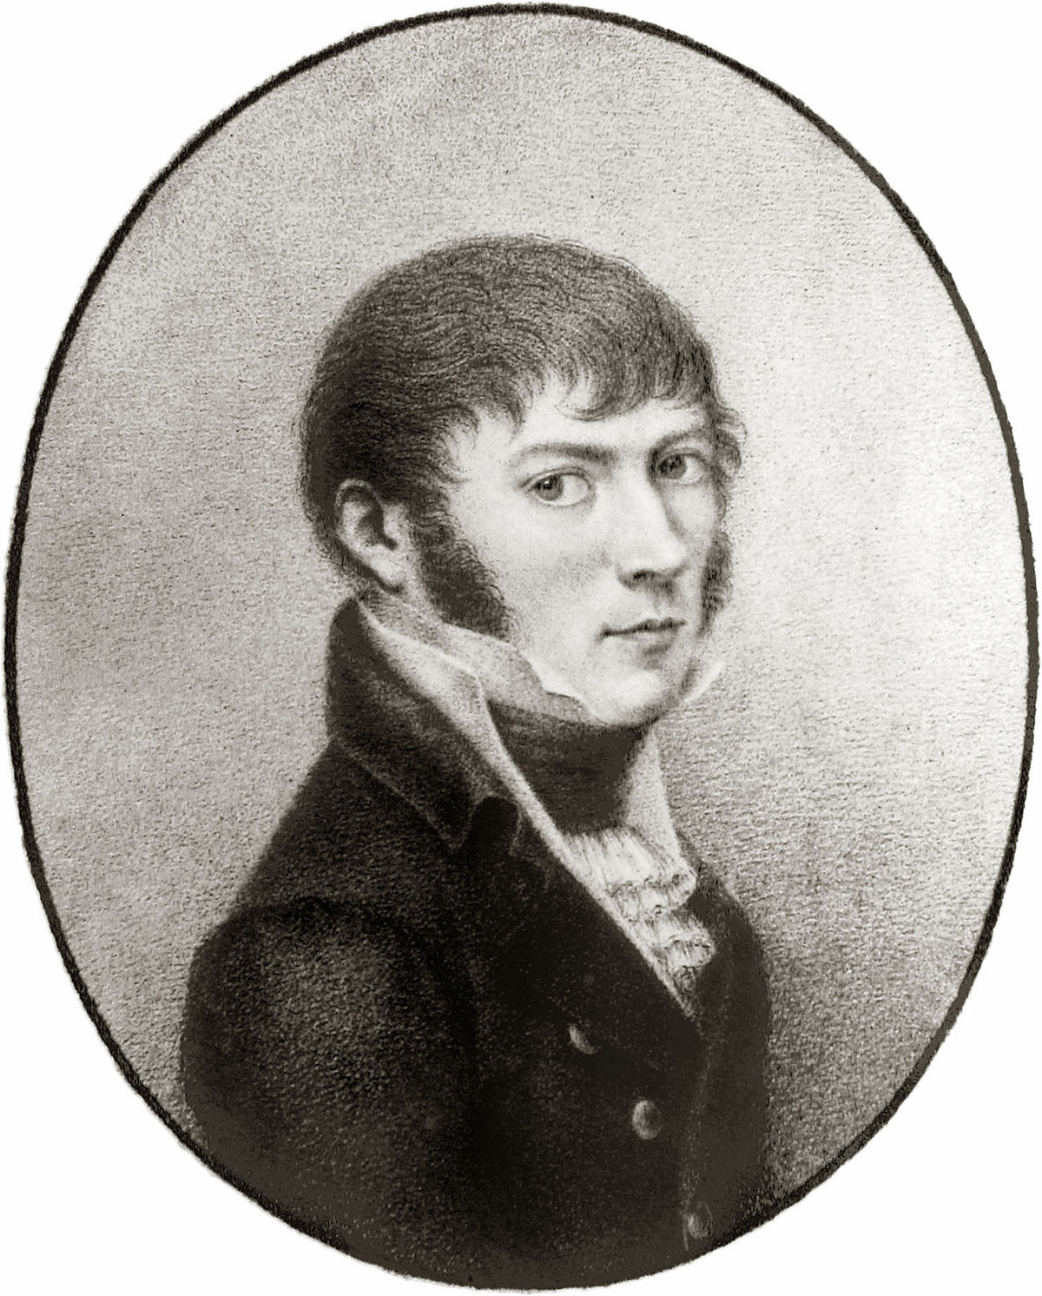
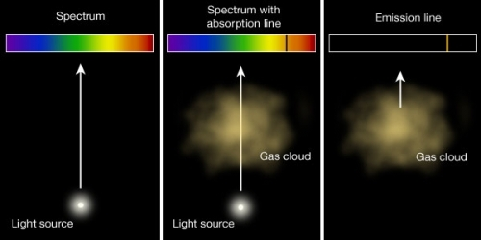
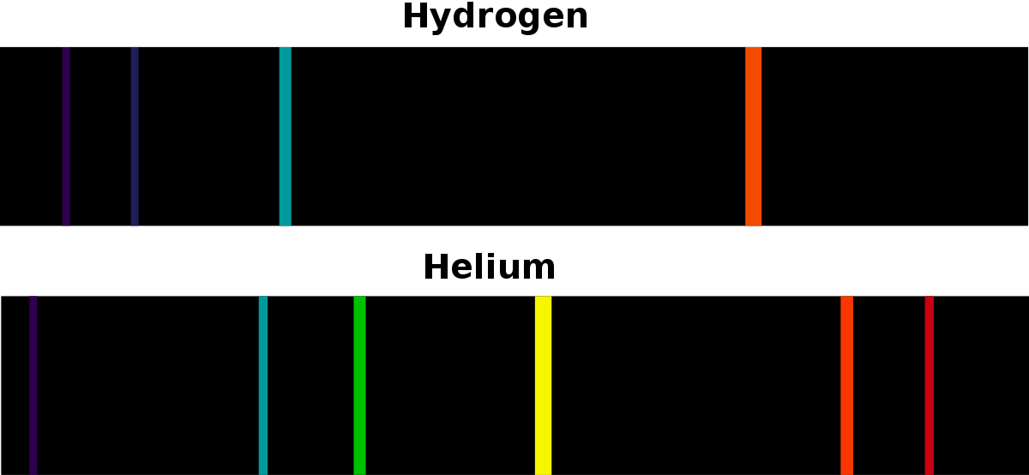
Spectral lines
Can use to measure composition of objects between us and stars, like gas clouds and atmosphere of (extrasolar) planets
Can measure abundance of elements in the stars
  Why the second element in the periodic table is called Helium?
Because if was first discovered on the Sun (Helios) using spectral lines.
Joseph von Fraunhofer – invented spectroscope and diffraction grating (discussed in the lab)

Slide 8
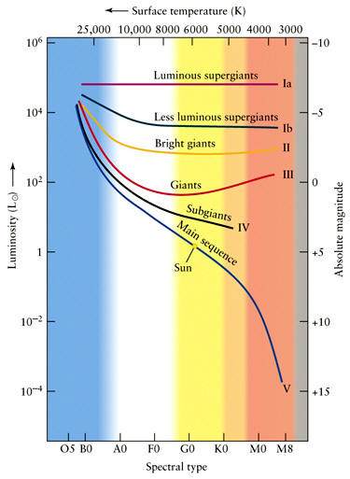
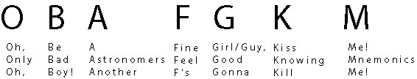
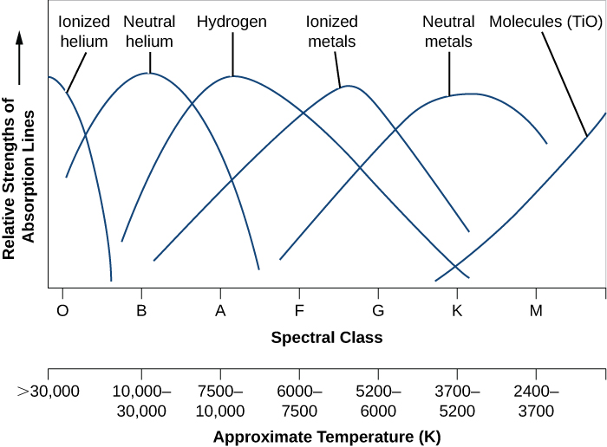
Stellar spectra classification
OBAFGKM are the main classes from hot to cold star surface temperature. There are additional classes for even hotter and colder ones.
Subclasses: F4, G9, etc.
Further division: G2V (The Sun)
Spectral Class | Color | Approximate Temperature (K)
O | Blue | > 30,000
B | Blue-white | 10,000–30,000
A | White | 7500–10,000
F | Yellow-white | 6000–7500
G | Yellow | 5200–6000
K | Orange | 3700–5200
M | Red | 2400–3700

Slide 9
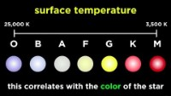
https://www.youtube.com/watch?v=Y5VU3Mp6abI

Slide 10
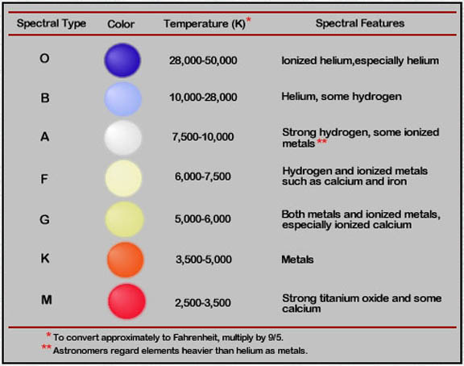
Any Questions?

